Slide 1

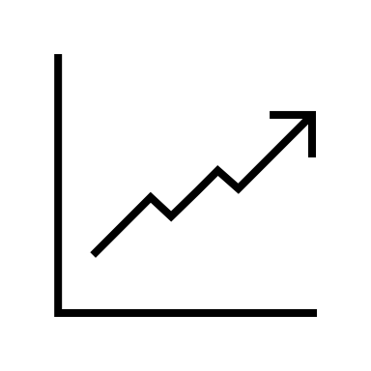
IS6400:
Business Data Analytics
Regression for Prediction
Notes:
Regression is probably one of the most commonly adopted statistical techniques. Our first question, why regression, seems totally unnecessary given the prevalence of this approach. The central idea of regression is to try to predict the average outcome based on a given set of variables.
It is important to emphasize the adjective average in this brief description here. Instead of trying to precisely capture idiosyncrasy for every single individual in the dataset, the objective of regression is to make a compromise and produce predictions about how individuals may be like on average.

Slide 2

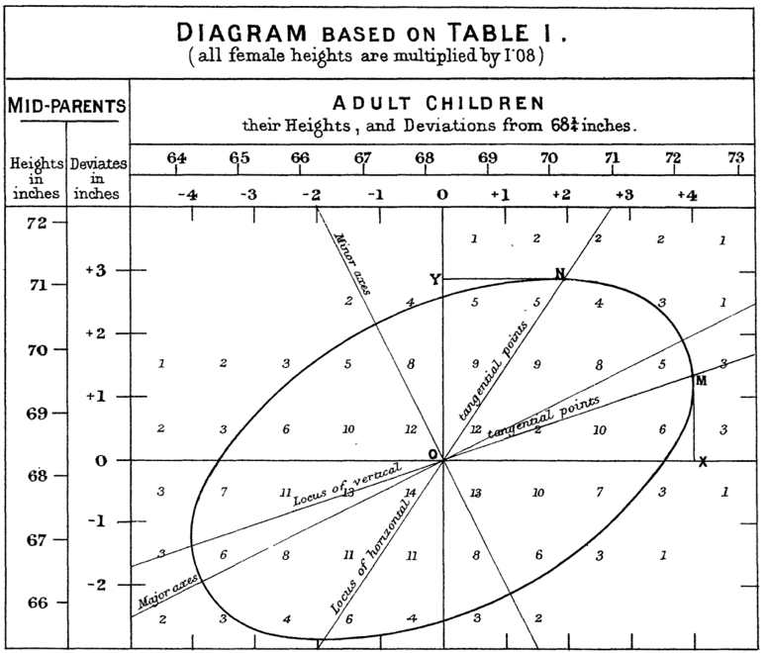
Regression: The Origin
Galton, F. (1886). Regression towards mediocrity in hereditary stature. The Journal of the Anthropological Institute of Great Britain and Ireland, 15, 246-263.
Notes:
The first time this term appeared in the academia was 1886:
Galton, F. (1886). Regression towards mediocrity in hereditary stature. The Journal of the Anthropological Institute of Great Britain and Ireland, 15, 246-263.

Slide 3
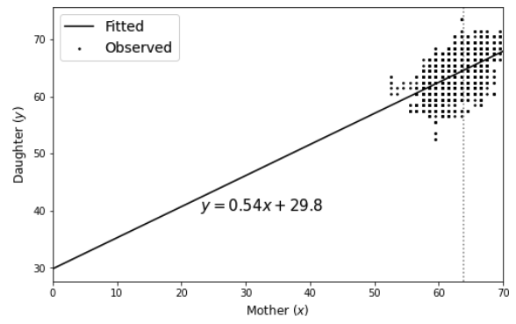
Reproducing the regression
Data from [LINK]
Notes:
At the time, Galton discovered that there is a correlation between children and their parents. Moreover, the deviation of children's heights from the mean is expeceted to be less than that of their parents.
Consequently, the original use of the term "regression" was not to describe a statistical method but a description of his findings (a.k.a., regression to the mean). Gradually, the meaning of "regression" has already been expanded to refer to such line fitting approach for identifying linear relationships between variables.

Slide 4
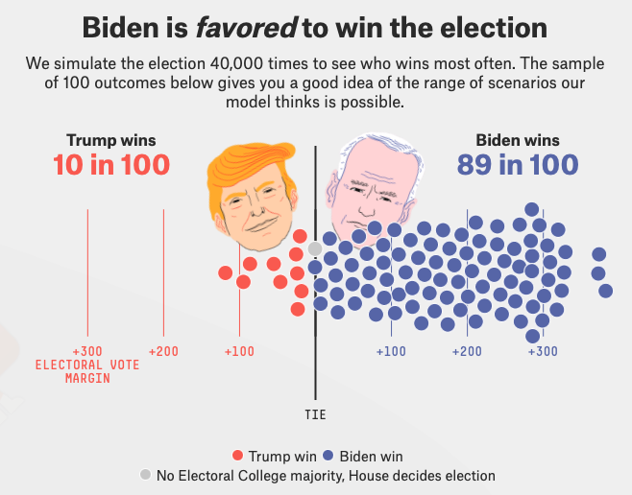
Regression Use Cases
Prediction (Our focus)
[LINK]
Notes:
Prediction: The most straightforward application of regression is probably prediction -- given past observations, we want to predict future values of a given target. Examples include the prediction of bitcoin prices, product sales, or election results. This is also the focus of our class today.
A cool example is the 2020 U.S. presidential election prediction conducted by FiveThirtyEight.

Slide 5

Regression Use Cases
Explanation!
The credibility revolution
Notes:
In social sciences, researchers utilize regression approaches to understand correlations between variables of interests. For instance, many recent interests lie on the analysis of how social distancing affects the COVID-19 pandemic severity.
Furthermore, since the credibility revolution in the field of economics, there has been strong emphasis on proper and rigorous identification of causal effects rather than simply association, the latter of which may oftentimes be misleading.

Slide 6
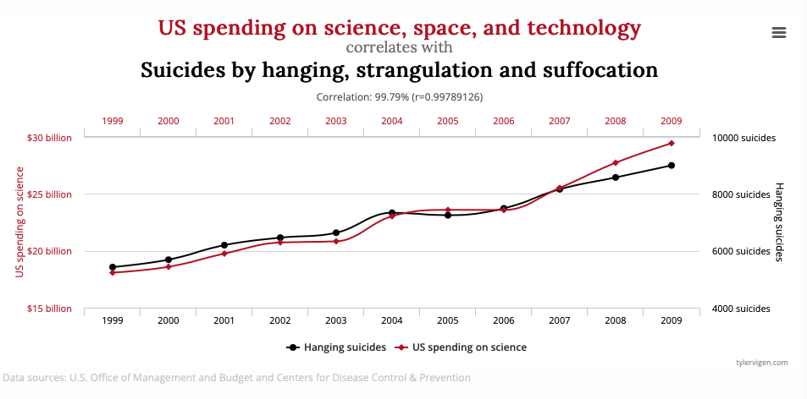
Regression Use Cases
Explanation!
Spurious correlation
http://tylervigen.com/spurious-correlations
Notes:
Correlations due to noise or confounding rather than causal links.

Slide 7
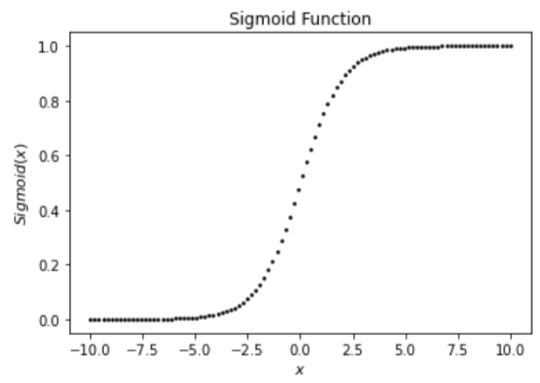

Regression vs. Classification?
Regression for continuous outcome
Classification for discrete outcome
Yet…
Notes:
it is worth noting that classification can be thought of a specific case of regression. In the simple case of a binary prediction, for instance, a non-linear transformation can be applied on top of the linear regression model in order to produce values between 0 and 1. Such values can be interpreted as the probability of being 1 (a.k.a., having the positive class label).

Slide 8

Starting the journey…
The anatomy of simple linear regression:
Predictor or feature
Continuous outcome
Random noise with zero-mean
Correlation/Slope
Intercept
Notes:
𝛽1 is the regression slope capturing the correlation between 𝑥x and 𝑦y
𝛽0 is the regression intercept, i.e., the predicted value of 𝑦y when 𝑥=0x=0
𝜖 is the random noise that our model is unable to capture. It is assumed that ϵ∼N(0,σ2).
Interpretation of the model is intuitive: an increase in one unit of 𝑥 is expected to be associated with 𝛽1 unit increase in 𝑦.

Slide 9
Regression in action
Error: deviation of the line from the points
Continuous outcome
Predictor or feature
Intercept
Correlation/Slope

Slide 10

But how do we get there?
How do we pick proper values of the parameters to produce good predictions?
What is a good prediction?

Slide 11
Measuring prediction performance
Qualitatively, the closer our predicted values to true values are, the better we perform.
Is this red line better than the black one?
Notes:
Intuitively, we are trying to model our data - that is, we are trying to make this simple linear regression predict the target given a subject's information. A mathematically equivalent way to say this is that we want to minize the error the model can make. Put differently, we have an objective function that we want to optimize (in this context, reaching the minimum)

Slide 12

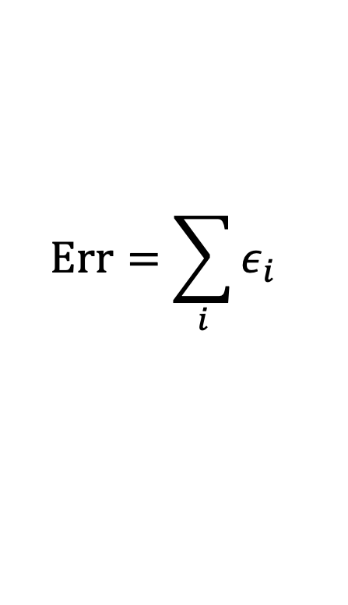
Error measurement
Intuitively, we can just contrast the predicted and true values to obtain their numerical difference.
$$ε_{i}=y_{i}−(β_{1}x_{i}+β_{0})$$
$$\text{Err}=\sum_{i}{ε_{i}}$$
Is this appropriate?

Slide 13
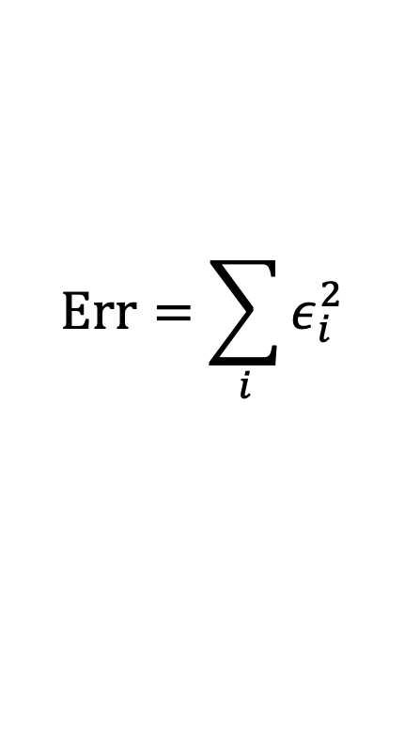
Error measurement: Squared Error
But errors of different signs may cancel out!
$$ε_{i}=y_{i}−(β_{1}x_{i}+β_{0})$$
$$\text{Err}=\sum_{i}{ε_{i}^{2}}$$
Let’s square it then!

Slide 14


Now that we have the error…
What do we want from a regression model?
Least square!
For math convenience only.

Slide 15
How do we infer the parameters?
How do we get betas’ to minimize the error?
Intuitively, we could search through some space…

Slide 16


Intuitive Approach: Grid Search
We make a ”grid” of candidate values
$$β_{0}$$
[100,100] | [100,99] | … | … | … | [100,1]
… | … |  |  |  | …
 |  | …
 |  |  | …
 |  |  |  | …
[1, 100] | [1, 99] | … | … | … | [1,1]
$$β_{1}$$
Compute MSE on each of these cells. The parameter values with the smallest MSE are considered “good” parameters.

Slide 17
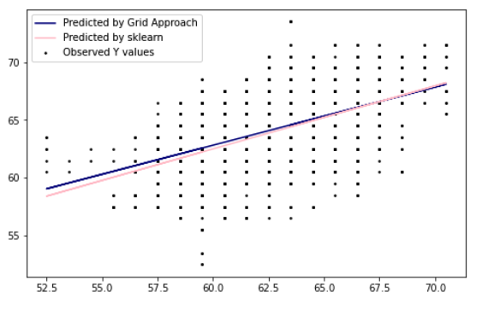
Intuitive Approach: Grid Search
Notes:
Performance is satisfactory.. But!

Slide 18
But this is inefficient…
What if the true parameters happen to be out of the grid?
What if we have 10 parameters in this model?
This will make our search space too high.

Slide 19
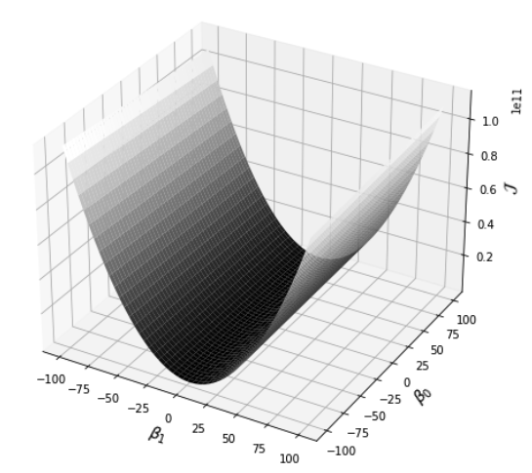
What do we learn from grid search?
Does it look like a U-shaped curve?

Slide 20
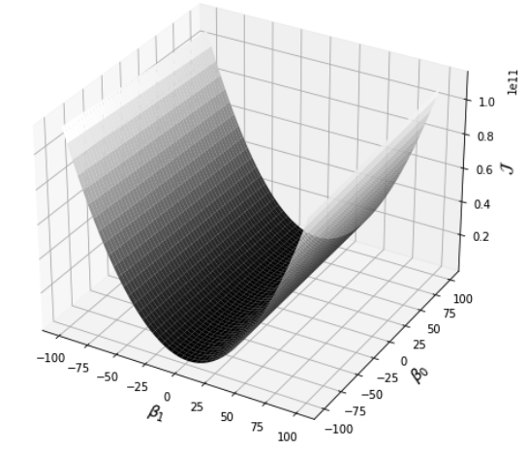
We can walk faster, can’t we?
Instead of walking randomly, maybe we could try walk along the downhill direction.

Slide 21

Walking down the hill
Gradient Descent:
Iterative update of the parameters to push them walking down the hill.

Slide 22
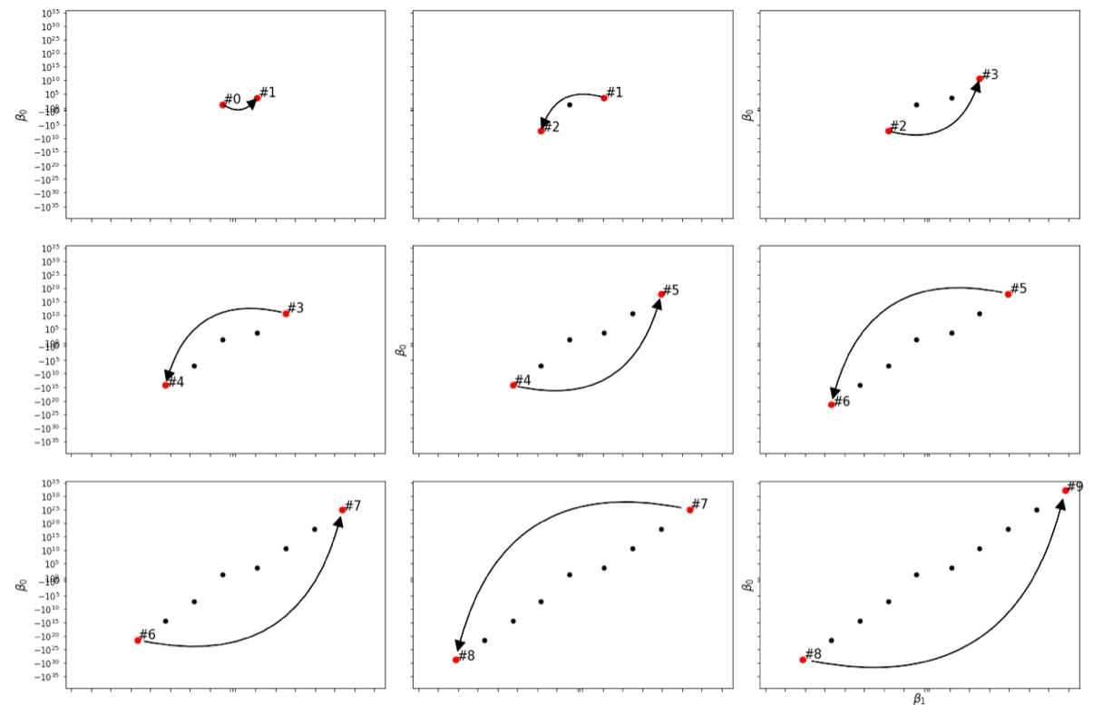
However, we need to walk slowly
Throughout the iterations, the parameter values are diverging.
Notes:
Step size

Slide 23
However, we need to walk slowly

Slide 24

However, we need to walk slowly
Learning rate

Slide 25
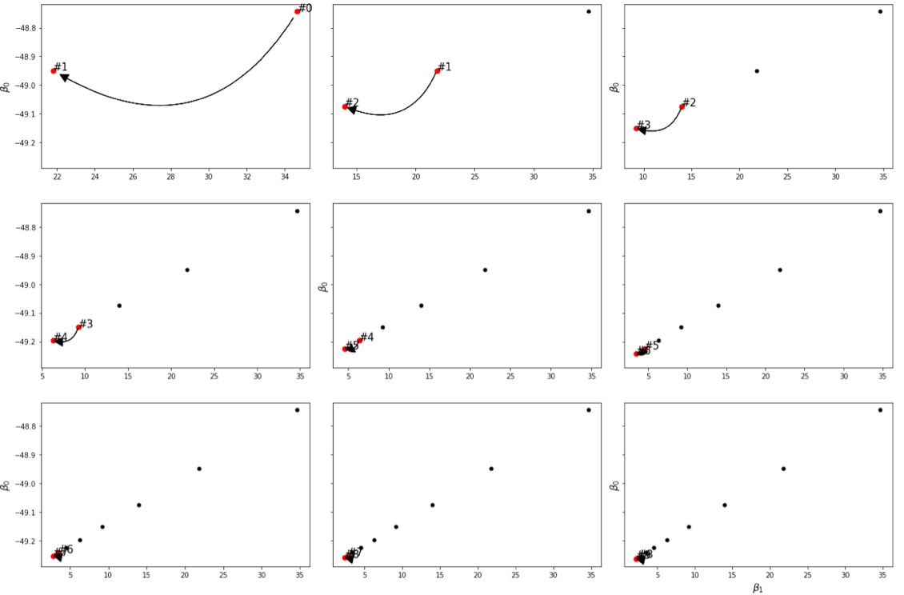
Now it works better…

Slide 26
Can we directly go to the best point?
Convex! There is a global optimum!

Slide 27



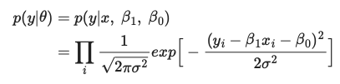
A Probabilistic Perspective (Optional)

Slide 28
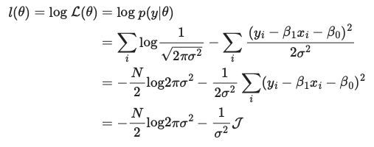
A Probabilistic Perspective (Optional)
Log-transformation to turn products into summations.
MLE is equivalent to Least Square!

Slide 29





A Probabilistic Perspective (Optional)
Set partial derivatives to zeros.
See notebook for the comparison on the estimated parameters between sklearn’s output and our manual computation

Slide 30
Recap: Parameter Estimation
What are we doing when we train a prediction mode?
This applies to various machine learning models for prediction.
We are walking on the parameter space, looking for those who achieve the lowest error possible.

Slide 31

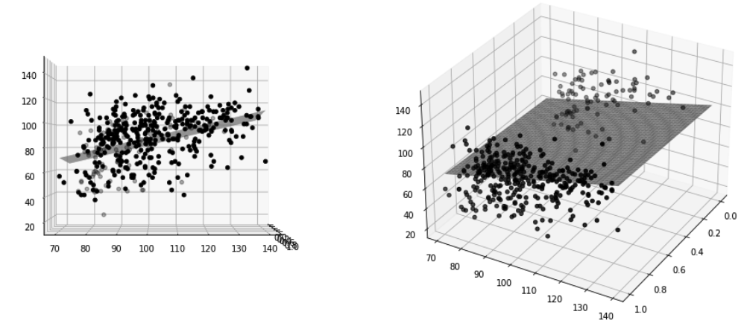
Multiple Linear Regression

Slide 32
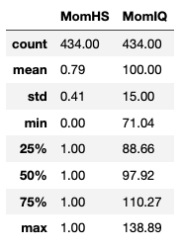
Caveat in Interpretation
Is MonHighSchool a better predictor than MomIQ?

Slide 33
Caveat in Interpretation
Suggestion: Standardize the dataset such that the interpretation becomes:
“1 SD increase in X is associated with some SD increase in Y”
Caveat: When we have train/test split, we need to standardize test data based on the train data.

Slide 34
Prediction Performance Evaluation
All the data we have
Split into train/test
Data for model fitting (training)
Testing
How do know if the splitting is representative?

Slide 35


(K-Fold) Cross Validation
All the data we have
Split into 5 equal folds
(Could be other number)
Fold 1
Fold 2
Fold 3
Fold 4
Fold 5
Test error on Fold 5
Our prediction model.
Performance evaluation.

Slide 36
(K-Fold) Cross Validation
All the data we have
Fold 1
Fold 2
Fold 3
Fold 4
Fold 5
Test error on Fold 4
Our prediction model.
Performance evaluation.

Slide 37
(K-Fold) Cross Validation
All the data we have
Fold 1
Fold 2
Fold 3
Fold 4
Fold 5
Test error on Fold 3
Our prediction model.
Performance evaluation.

Slide 38
(K-Fold) Cross Validation
All the data we have
Fold 1
Fold 2
Fold 3
Fold 4
Fold 5
Generalization error:
Average test errors across all folds
Our prediction model.
Performance evaluation.

Slide 39
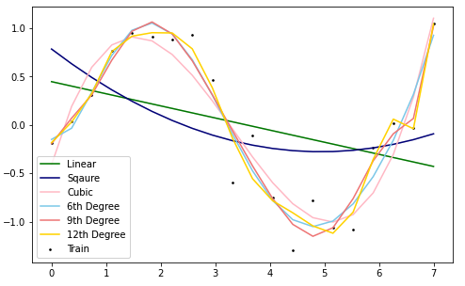
Overfitting: Fit the pattern or noise?
Look at the orange line (polynomial regression with an order of 12).
Do you think it is good or bad?

Slide 40
Overfitting: Fit the pattern or noise?
Overfitting: the model is ”trying too hard to fit every single training sample” such that it loses generalization.

Slide 41
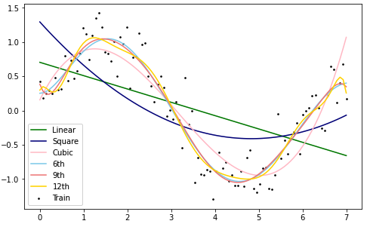
Overfitting Solution 1: More data!
Complex models look “smoother” when more data is given.

Slide 42
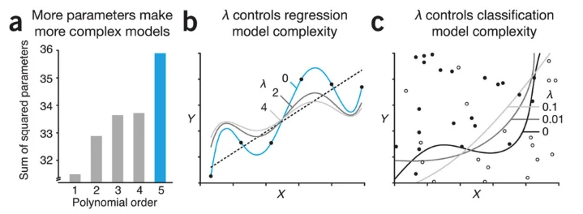
But data is expensive
Can we mitigate this issue by tweaking our model?
Source: https://www.nature.com/articles/nmeth.4014

Slide 43

Regularization to the rescue
A model is more flexible with more parameters, which is often associated greater parameter magnitude
Ridge regression (i.e., linear regression with L-2 norm regularization)

Slide 44


Regularization: Lasso and Elastic Net
Lasso regression (i.e., linear regression with L-1 norm regularization)
Look them up in scikit-learn!
Elastic net regression (i.e., linear regression with L-1and L-2 norm regularization)

Slide 45
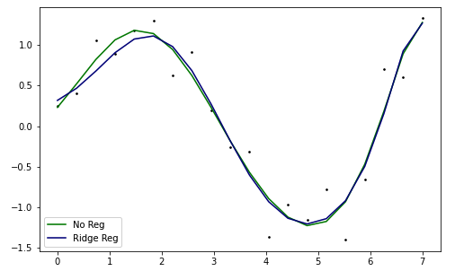
How does it work?
Regularization makes the model less specific to the noise!
You are encouraged to try more examples using the lecture notebook!

Slide 46
Advanced topics: GLM
GLM: Generalized Linear Model
Useful when target variable is not real number.
Examples: Count data (car accidents, elections, etc.) or binary target (two-class prediction)

Slide 47
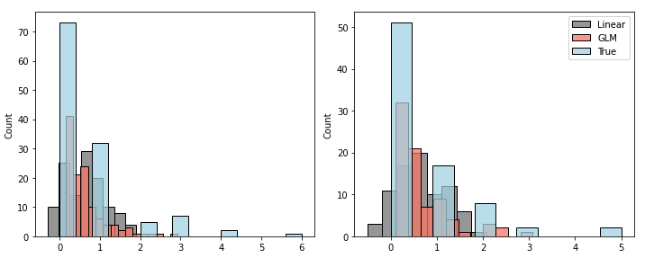
Example: Poisson reg. (count data)
True data is discrete count.
Train
Test
Obvious Poisson regression better fits the distribution

Slide 48
Advanced topics: Non-parametric
Parametric models: a fixed set of model parameters regardless of sample size.
E.g., a linear regression with 4 variables will have 4 slopes and 1 intercept (as well as the error term variance) no matter how many rows we have

Slide 49
Advanced topics: Non-parametric
Non-Parametric models: a dynamic number of model parameters given different sample sizes.
E.g., Gaussian Process
It models the target using a mixture of Gaussian distributions.
Good tutorial on this if interested (optional):
https://distill.pub/2019/visual-exploration-gaussian-processes/

Slide 50
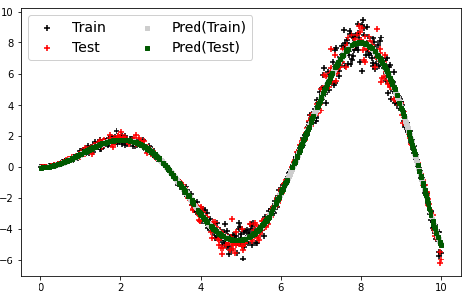
Example: GP regression

Slide 51
Suggested References
Bishop, Christopher M. (2006). Pattern recognition and machine learning. New York :Springer.
Gelman, A., Hill, J., & Vehtari, A. (2020). Regression and other stories. Cambridge University Press.
Murphy, K. P. (2012). Machine learning: a probabilistic perspective. MIT press.

Slide 52

The End

